Slide 1
Project Plan Auditing Guidelines on Land organization and soil quality Management – Combating Desertification
By SAI Pakistan
INTOSAI WGEA Secretariat
15th WGEA Steering Committee, Review & Approve Project Plan
Washington DC, USA
11-14 Sep, 2017

Slide 2
Project Team
SAI Pakistan
Mrs.Rukhasana Rafique Project Leader
Mrs.Sidra Shafique Team Member
Mrs.Ammara Waheed Team Member
SAI Lesotho
Mrs.Manako Ramonate Team Member
Liaison Officer of SAI Pakistan to WGEA
Rana Shakeel Asghar

Slide 3
Land Degradation Neutral World
Source: UNCCD

Slide 4
Understanding of The Topic
“Auditing Guidelines on Land organization and soil quality Management – Combating Desertification”

Slide 5
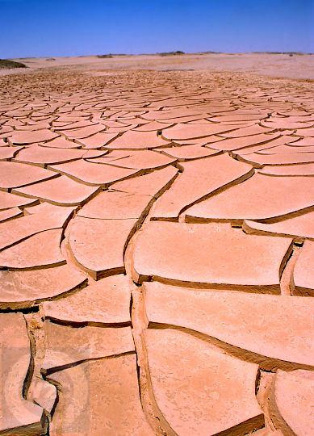
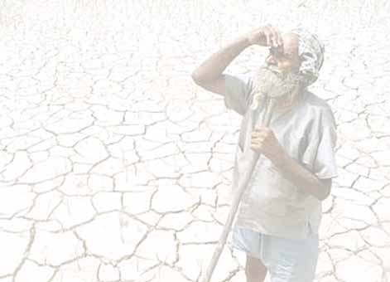
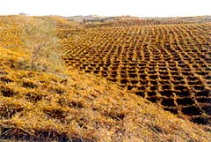
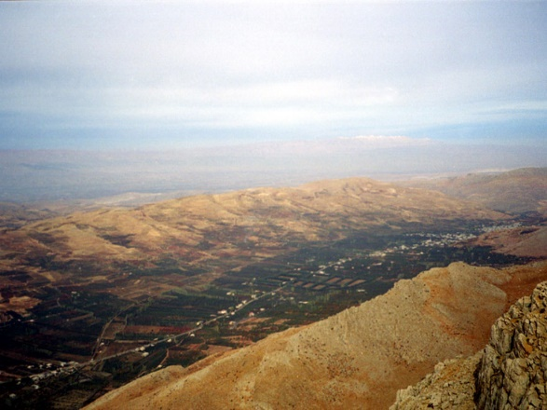
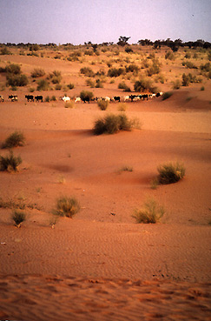
What is Desertification?
Process of land degradation in arid, semi arid and dry sub humid areas that is the results of several factors; including human activities and climate variation. (UNCCD, 1999)
It involves:
Loss of biological or economic productivity
Complexity in cropland, pastures and woodlands

Slide 6
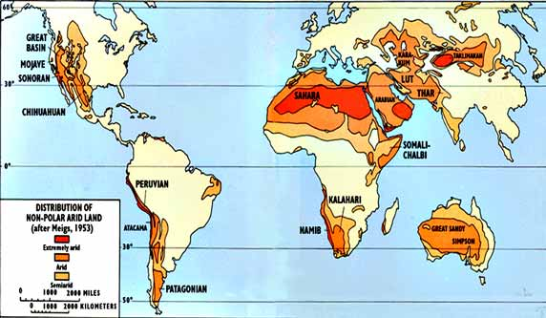
Deserts
Notes:
Insert a map of your country.

Slide 7
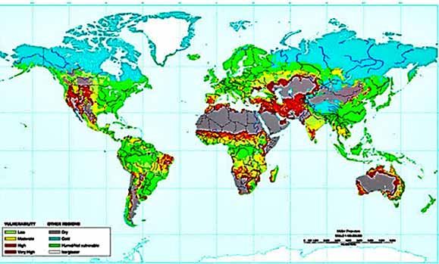
Which areas are vulnerable?
Vulnerability: Red = very high Orange = high Yellow = moderate

Slide 8
Land: a scarce resource & a global common
Source: Earth: The Apple of Our Eye, Education Program l www.populationconnection.org/education
The U.S. Global change Research Information Office

Slide 9
Global Facts & Figures (Source: UNCCD)
2.6 billion people depend directly on agriculture
52% of the land used for agriculture is moderately or severely affected by soil degradation
Land degradation affects 1.5 billion people globally
Arable land loss estimated at 30 to 35 times the historical rate
Total land degradation affects some 1.9 billion hectares of land worldwide

Slide 10
Global Facts & Figures (Source: UNCCD)
24 billion tons of fertile soil disappear/year, the most significant, nonrenewable geo‐resource
Due to drought and desertification each year 12 million ha are lost (23ha/mn), where 20 million tons of grain could have been grown

Slide 11
Causes of Desertification
Following are the causes of desertification
Deforestation
Soil erosion and degradation
Clearing land for construction
Demographic and economic pressures

Slide 12
CLIMATE
Arid-semi arid
Extreme variability
Drought
SOILS
Soil liable to salinity and alkanization
Loose
Sandy Soils
VEGETATION
Savannah
Semi-deserts
Sand dunes
ECO SYSTEM
TOPOGRAPHY
Precondition leading to erosion hazards
Human Activities
Human Activities
Bush burning
Poor irrigation practice
Unbridle use of groundwater
Overgrazing and over exploitation
Poor land use practice
Deforestation
DESERTIFICATION PROCESS
Environmental Effects
Socio-Economic Effects
Reduction in river flow and groundwater level
Formation of dunes
Destruction of habitat and loss of Biodiversity
Soil erosion
Food insecurity
Decline in cash crops for export
Migration
Poverty
Resource use conflicts
Source: Adapted from Medugu (2007)

Slide 13
Global Partners in Combating Desertification
The Sustainable Development Goal (SDG Target 15.3) of United Nations
United Nations Convention to Combat Desertification (UNCCD)
Global Environment Facility (GEF)
International Union for Conservation of Nature (IUCN)
Food and Agriculture Organization (FAO)
United Nations Environment Program (UNEP)
And others

Slide 14
Global Initiative to combat desertification
110 countries have committed to set LDN targets
The Great Green Wall
The LDN Fund
The Global Land Outlook (GLO)
Capacity Building Marketplace
The Global Land Outlook (GLO)
Science-Policy interface (SPI)
The United Nations Decade for Deserts (2010-2020) and the fight against Desertification
Sustainability, Stability, Security

Slide 15
Management Tools to Combat Desertification
Land organization
Soil Quality Management
Afforestation
Sustainable Land Management

Slide 16
Project Objectives and Targets
Developing audit guidelines for SAIs
Orientation to SAIs on topic
Suggesting SAIs suitable auditing approaches
Sharing of best practices
Providing baseline information to SAIs for future research and further work on improvement of the guidelines

Slide 17
Project Scope
Auditing Land Organization & Soil Quality Management
Introduction
Understanding desertification
Causes of desertification
Significance of combating desertification
International/ National Response
SDGs/UNCCD/UNEP
Role of National Governments
Management tools to combat desertification

Slide 18
Project Scope
Auditing Land Organization & Soil Quality Management
How audit can influence the management of land
• Role of SAIs in combating desertification
• Major concerns and ongoing efforts of SAIs
Auditing Land Organization & soil Quality Management
Planning Stage
Identify the country’s land and major threats to it
Understand the government’s response to these threats
Select Audit topic
Decide on Audit Approach
Establishing Audit Criteria

Slide 19
Project Scope
Auditing Land Organization & Soil Quality Management
Execution Stage
Conduct Audit against audit criteria and review aspects of
Performance measurement and results
Reporting Stage
Framing audit results for the management
Topics for auditing land and soil management
Key topics for audit
Case studies

Slide 20
Methodology
The work will base on qualitative research methodology like feedback on questionnaires and surveys
Consultation with International and National researches, laws/Conventions, local policies and programs, Stakeholders and prestigious Research Institutes and audit experiences of all SAI’s
Effective legislations and regulations of different SAIs will be identified along with other policy tools, including grants, loans, subsidies, taxes, user charges, and service fees and programs, if any.

Slide 21
Methodology
Success stories of other SAIs will be asked through a survey from other SAI’s and experience will be provided through case study
SAI Pakistan is predominately an arid to semi-arid country. The case study of SAI Pakistan will be established by addressing the key issues of desertification in Pakistan

Slide 22
Format of Case Study
Title
Audit Objective
Audit Scope
Audit Criteria
Lines of Inquiry
Audit Findings
Audit Recommendations
Link For Full Report

Slide 23
Key Questions to SAI
What are the initiatives to combat desertification in the country?
What are the key threats in combating desertification?
What is the government doing about these threats?
Who are the players and what are their roles and responsibilities?
How the Government is achieving its objectives?

Slide 24
Key Questions to SAI
Provide a detail on following
Legislation and regulations
Policies and programs for soil
Economic tools and incentives
Voluntary partnerships
Environmental impact assessments
Public Awareness programs on combating desertification
Audit report, if any

Slide 25
Thank you!

