Slide 1
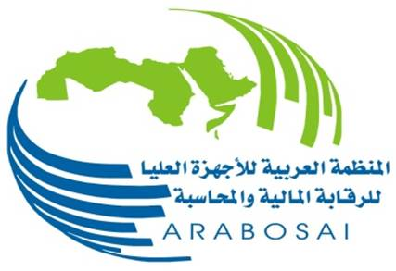
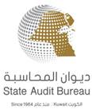
ARABOSAI RWGEA
Progress Report & Activities
15th Steering Committee Meeting
Washington DC, USA
11 – 14 September 2017

Slide 2
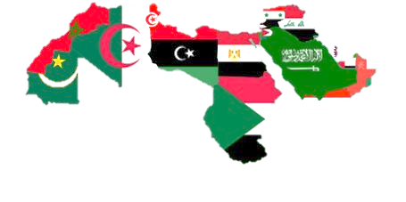
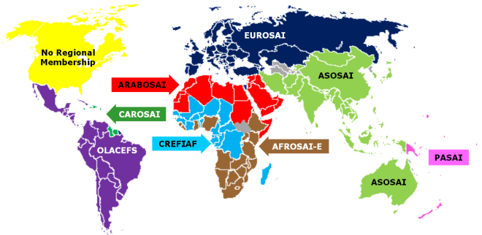
ARABOSAI RWGEA Progress Report & Activities
22 Countries

Slide 3
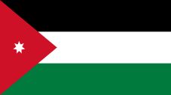
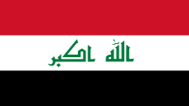
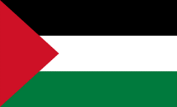
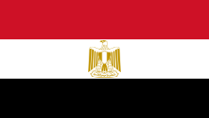
ARABOSAI RWGEA Background
The Working Group on Environmental Auditing of the Arabian Organization of Supreme Audit Institutions (ARABOSAI) initiated its work in May 2009.
Ten meetings were held of which three Work Plans were approved. Two of the Work Plans were fully achieved ( 2010-2012 & 2013-2015 ). The Third Work Plan ( 2016-2018) is still in process.
The ARABOSAI Working Group on Environmental Auditing consists Nine Countries as members: Jordan, Iraq, Kuwait, Yemen, Tunisia, Oman, Palestine, Egypt and Mauritania.

Slide 4
ARABOSAI RWGEA Progress Report & Activities
1
Work Plan 2016-2018.
2
The most important results of some of the research papers completed.
3
Proposed training programs.
4
Activities of the Working Group on Environmental Auditing.

Slide 5
ARABOSAI RWGEA Progress Report & Activities
1
Work Plan 2016-2018
Research Working Papers on the following Topics :
Topic | SAI in Charge
SAIs Role in Auditing the Environmental Impacts of Liquid Industrial Waste. | Kuwait & Iraq
Comparing the Environmental laws in the Arab Countries. | Egypt, Oman & Mauritania
SAIs Role in Auditing Public Parks & Landscapes. | Jordan & Tunisia & Kuwait
SAIs Role in Preparing a Procedural Guideline on Environmental Auditing. | Palestine & Kuwait
SAIs Role in Auditing the Impact of Communications Towers on the Environment & Humans. | Iraq
SAIs Role in Auditing the Coastline. | Oman & Tunisia
SAIs Role in Auditing the Natural Reserves. | Oman & Mauritania

Slide 6
ARABOSAI RWGEA Progress Report & Activities
1
Work Plan 2016-2018
Suggested Training Programs
Topic | SAI in Charge
Energy Audit Program | Jordan
Environmental Auditing Standards Program | Egypt
Medical Waste disposal Effectiveness Program | Kuwait
A seminar on Cooperative Joint Audit Procedures - Standard 5140

Slide 7
ARABOSAI RWGEA Progress Report & Activities
2
The Most Important Results of Some Research Papers Completed Include the Following:
SAIs Role in Auditing the Environmental Impacts of Liquid Industrial Waste.
SAIs of the State of Kuwait ,and the Republic of Iraq presented their audit experience, which highlighted the following results:
The presence of sewage and industrial wastewater discharged into the sea.
The discharge of liquid industrial waste from the illegal connections to the public sewage network leads to their disruption and blocking. By throwing these wastes into the sea, they cause severe damage to the marine environment.
High percentages of damage in chemical raw materials of the allowed standard rates due to the aging of production lines, which leads to their leakage into industrial wastewater.
Increased pollution resulting from production processes due to the increase of chemicals quantities in production, which have a direct impact when they are thrown into the surrounding environment.

Slide 8
ARABOSAI RWGEA Progress Report & Activities
2
The Most Important Results of Some Research Papers Completed Include the Following:
Comparing the Environmental laws in the Arab Countries. (laws, regulations, decisions) related to the environment.
• A comparative matrix of environmental laws has been prepared and work is under way to complete the study.
SAIs Role in Auditing Public Parks & Landscapes.
The SAIs of the State of Kuwait, the Kingdom of Jordan ,and the Republic of Tunisia presented their audit experience which highlighted the following results:
Some of the planned targets within the Parks Department operational plan are not compatible with what is the actually Implemented.
The inadequacy of some public parks designs with the nature of the activity and the population of the area in which they are located.
Poor efficiency and effectiveness of projects due to failure in applying the principle of accountability.
The lack of conformity of some of the executed works with the technical drawings and specifications.
The lack for maintenance in some parks green spaces.

Slide 9
ARABOSAI RWGEA Progress Report & Activities
2
The Most Important Results of Some Research Papers Completed Include the Following:
SAIs Role in Preparing a Procedural Guideline on Environmental Auditing.
• Work is under way on the preparation of a draft Guideline on Environmental Auditing submitted by the Financial and Administrative Control Bureau in the State of Palestine.
SAIs Role in Auditing the Impact of Communications Towers on the Environment & Humans.
The SAIs of the State of Kuwait ,and the Republic of Iraq presented their audit experience, which highlighted the following results:
The absence of a database of the Ministry of Health and the Environment, especially for Internet companies, despite the presence of these towers in density populated residential areas and in large numbers.
Failure to enforce fines on infringing towers.
Urbanization approach of high voltage networks.

Slide 10
ARABOSAI RWGEA Progress Report & Activities
2
The Most Important Results of some Research Papers Completed include the Following:
SAIs Role in Auditing the Coastline.
The Court of Accounts of the Republic of Tunisia presented their audit experience, which highlighted the following results:
Pollution of a variety of forms that can cause environmental disasters on marine resources, coastal activities , flora and fauna.
Lack of control over the occupation of coastal space, causing chaotic construction.
Degradation of environmental systems, such as coastal wetlands adjacent to urban areas.
Lack of funding necessary to carry out the work preparation for the turf protection.

Slide 11
ARABOSAI RWGEA Progress Report & Activities
2
The Most Important Results of some Research Papers Completed include the Following
SAIs Role in Auditing the Natural Reserves.
The SAIs of the Sultanate of Oman ,and the Republic of Mauritania presented their audit experience, which highlighted the following results:
Absence of a strategic vision and clear plans for the management of natural reserves ,and non-follow-up to achieve the aimed goals.
Lack of service projects implementation , the establishment of clear boundaries , rehabilitation of natural reserves, the lack of a provision for control tools , adoption of necessary measures ,and the weak control.
Frequent violations on natural resources within the protected areas ,and the poor coordination with relevant governmental institutions in relation to the protected areas management .
Lack of the local community involvement in protecting the natural resources of the reserves, not benefiting from local and international experiences in the management of nature reserves.

Slide 12
ARABOSAI RWGEA Progress Report & Activities
3
Proposed training programs
1-Energy Auditing Program
2- Environmental Auditing Standards Program
The preparation of the training program pivots, and the coordination with the specialized committee of the Arab Organization(ARABOSAI) to include the program within the training plan.
3-Evaluating the Efficiency of Medical Waste Disposal Program.
The program was approved and held in the State of Kuwait during the period from 11-13 / 9/2017
4-Joint Collaborative Review Procedures (Standard 5140)
Coordination is under way for the establishment of a joint cooperative review procedure (standard 5140) as a prelude to a joint review work.

Slide 13
ARABOSAI RWGEA Progress Report & Activities
4
Activities of the Working Group on Environmental Auditing
Attending the 14th Annual Meeting of the EUROSAI Working Group on Environmental Audit ,and the Seminar on Sustainable Development held in the Republic of Macedonia 26-29 September 2016.
Participation in the 17th Meeting of the INTOSAI Working Group on Environmental Auditing, held in Jakarta, 24-27 October 2016.
SAI of Kuwait hosted Dr. Alar Karis, Head of the EUROSAI Working Group on Environmental Auditing in the 10th Meeting, where he presented a valuable work paper relating to the importance of integrating the Environmental Audit Plan with Sustainable Development Plan, cooperative audit, and communication with audit communities.

Slide 14
ARABOSAI RWGEA Progress Report & Activities
4
Activities of the Working Group on Environmental Auditing
Presentation of a workshop on the report "Evaluation of the of Efforts Efficiency to Protect Fish Resources from Overfishing" at the 10th Meeting of the Working Group on Environmental Auditing held in Kuwait in 2017.
Presentation and discussion of the INTOSAI Environmental Auditing Plan 2017-2019, where as the members of the working Group agreed to participate in the first strategic objective of the INTOSAI Environmental Auditing Plan 2017-2019 related to developing, updating the guidance and materials available for SAIs. As a participation in Activity no.4 " The Development of an Audit Manual on how SAIs can Strengthen the Role of Governments in Implementing the United Nations Goals of Sustainable Development “.
The Republic of Iraq has chosen to participate in the subject of wastewater, chaired by Morocco. The Arab Republic of Egypt has chosen environmental health (air pollution focus), chaired by the Philippines.

Slide 15
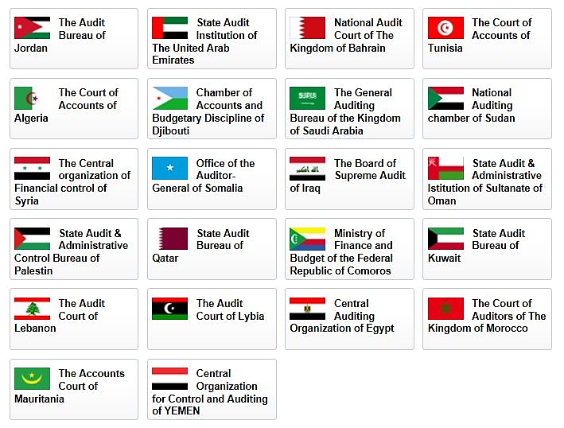
THANK YOU
PRESENTED BY:
Sultan AlOtaibi
Shaikha AlAdwani

