Slide 1
UPDATING THE 2007 INTOSAI WGEA DOCUMENT: AUDITING BIODIVERSITY: GUIDANCE FOR SAIs
SAI LESOTHO & SAI INDONESIA
WASHINGTON D.C.,
13 SEPTEMBER 2017

Slide 2
AGENDA
BACKGROUND
OBJECTIVES
SCOPE
PROJECT TEAM MEMBERS
METHODOLOGY
INPUTS RECEIVED
PLANNED TABLE OF CONTENTS
TIMETABLE
CONTACT PERSON

Slide 3
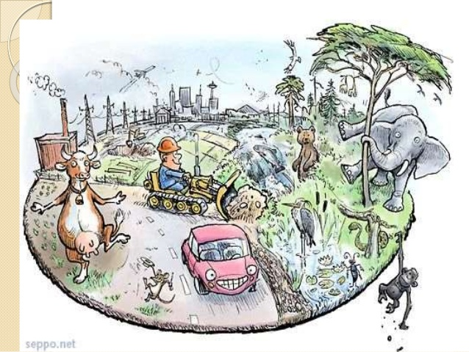
BACKGROUND
The continuously degraded living environment;
Recent developments in Biodiversity issue (Agenda 2030);
The recent development of Strategic Plan for Biodiversity 2011-2020;
Current audit issues on Biodiversity.
In 2007, WGEA has already have a Guidance, and
updates made to that document is considered
necessary.

Slide 4
OBJECTIVES
The project aims to update the INTOSAI WGEA 2007 Guidance Material on Auditing Biodiversity through:
Providing recent development on Biodiversity and how it has impacted the National Governments;
Providing recent case studies based on the recent reports submitted to WGEA Database, recent national reports and interaction between CBD and other parties;
Providing an improved audit steps and methods to perform Biodiversity audit ;
Mainstreaming Biodiversity as it fosters the implementation of Agenda 2030.

Slide 5
SCOPE
The updated guidance will follow the outline of the published Guidance of 2007 which was as follow:
Introduction of the topic which include the international awareness, importance of biodiversity protection, and audits of biodiversity;(maybe we can also include here, the new developments since the last published guideline?)
Background on Biodiversity which include the scope, main threats and how it can be protected;
Choosing and Designing Audits of Biodiversity which explained main steps in designing audit in Biodiversity;
Audits of Biodiversity where several topics related to biodiversity will be explained through updated case studies from audits performed by SAIs worldwide based on WGEA Database.
In the updated guidance, several appendices will be adjusted, especially ones contained with “no-longer” relevant data or outdated data.

Slide 6
PROJECT TEAM MEMBERS
CO-LEADERS : SAI LESOTHO AND SAI INDONESIA
SUBCOMMITTEE MEMBERS:
SAI BRAZIL
SAI CAMEROON
SAI CHINA
SAI ESTONIA
ECA
SAI NIGERIA
PARTNER : UN-CBD

Slide 7
METHODOLOGY
Literature Study
Consultation with UN-CBD
Data mining on WGEA Data Base on Biodiversity Audits
Skype/In-depth interview/email communication with SAIs that have an outstanding performance in auditing biodiversity issues or innovation to audit biodiversity issues
Small survey could be performed to regional coordinators to update issues related to Biodiversity policy within their regions.

Slide 8
INPUTS RECEIVED FROM SAIS
SAI | INPUTS | RESPONSE
ECA | Shortening the background with particular focus to the need of updating current guidance document What is meant under recent development on Biodiversity? Is it meant recent legislative and strategic developments on Biodiversity? In terms of recent case studies, we would suggest this to be the last step in the update, and not limiting the sources to the WGEA database, as they might be outdated at this stage. Further clarification on “improved audit steps” is needed, and “Mainstreaming Biodiversity as it fosters the implementation of Agenda 2030” should be explained. It should be clarified what steps in choosing and designing audit on biodiversity are meant here and what is the difference with the usual ones in the auditing standards and guidelines. Is it meant that to the main standards will be referenced and only specific criteria or others will be elaborated? The information provided in the paragraph in one sentence needs to be structured and elaborated, e.g. there are three issues mentioned apart from literature review. What do we do with “Performance Audit, and Special Purpose Audit”, and what is “case/audit reports studies in the field of Biodiversity”? Does it mean the case studies to be collected and included in the guidance document? What is the objective to carry out a survey; does it intend to provide additional information on what needs to be updated? | Generally agree with shortening the background Recent developments include the SDGs, the result of COP 13 and other tools used in measuring Biodiversity Recent case studies will be obtained through data from all around the world with the help of CBD Improved audit steps actually we plan to add latest improvement in audit tools in Biodiversity issues. Mainstreaming Biodiversity to achieve SDGs means the audit on biodiversity should underline the biodiversity issue to support the achievement of SDGs target related to it. Performance and special purpose audit that have been be performed by SAIs to audit issue of biodiversity Case and audit reports will be collected with the help of CBD Survey will be performed to update on the information regarding the national policy/regional policy of biodiversity

Slide 9
INPUTS RECEIVED
SAI | INPUTS | RESPONSE
CHINA | For the Introduction of Guidance, we suggest that add the expression like “the need of regional cooperation for carrying out audits of biodiversity ” For the Chapter 1: Background on Biodiversity of Guidance, we suggest that add the expression like “some SAIs pay constant attention to the biodiversity audits, and have taken good effect on achieving the 2020 goals”. | Agree to include the suggestion within the Chapter I as it could motivate and encourage other nationalities to perform better measures to achieve the Aichi Targets.
INDIA | The research paper could also include considerations for SAIs before starting the audit to increase the post-audit visibility of audit report. The research paper could highlight how the SAIs are / could use the internet for widespread dissemination of the environmental audit results/databases, for fast retrieval of relevant information by various stakeholders. | Need more clarification regarding the suggestion. Agree to highlight the issue within the Chapter 2. Choosing and Designing Audits of Biodiversity.
CZECH REPUBLIC | The project plan is very clear and comprehensible. We suggest only to add who will be the subcommittee members of this project and whether the colleagues from the SAI Brazil and the SAI Canada (the main authors of the INTOSAI Guidance from 2007) are expected to participate in this project. | Currently SAI of Brazil is one of the Project Members.

Slide 10
PLANNED TABLE OF CONTENTS
The table of contents will slightly adjust the current document.
Planned table of contents:
Introduction
Additional issue on Nagoya Protocol and Agenda 2030
Recent development in technology to audit Biodiversity
Chapter I. Background on Biodiversity
Additional discussion on results of COP 13 and Strategic Plan of Biodiversity
Progress/Achievement made by countries in achieving Biodiversity targets

Slide 11
PLANNED TABLE OF CONTENTS (cont’d)
Chapter 2. Choosing and Designing Audits of Biodiversity → additional discussion on new Biodiversity tools could be used by Auditors
Chapter 3. Audits of Biodiversity → updates with recent audits and discuss how the audits could relate with the achievement of SDGs targets.
Appendix 1 and 3 → planned to be deleted and merged into the body of paper
Appendix 2 → planned to be updated with recent addition from regionals
Appendix 4 → planned to be replaced with Aichi Targets and SDGs targets (related with Biodiversity)

Slide 12
TIMETABLES
Stage | Action | Date
1 | Final Draft of Project Plan to WGEA Secretariat | May 2017
2 | Receive comments from Steering Committee | May - June 2017
3 | 15th Steering Committee, review and approve Project Plan | Washington USA, September 11 - 14 2017
4 | Final version of the Project Plan | October 2017
5 | Elaborated table of contents of the Project to the Secretariat | December 2017
6 | 18th WGEA Assembly | March 2018
7 | 16th Steering Committee meeting, approval of the Projects output, discussion of the next work plan | November 2018
8 | Final draft of the Project output to the Secretariat | February 2019
9 | Final version of the Project output – translation, editing, printing etc | June 2019
10 | 19th WGEA Assembly | September 2019

Slide 13
CONTACT PERSON
Country : Lesotho
Name : Manako Ramonate
E-mail : mmanakor@yahoo.com
Tel : (+266) 58717649 mobile OR (+266) 22317625/22314247
Country : Indonesia
Name : Dominika Rosana
E-mail : dominika.rosana@bpk.go.id
Tel : +6221-25549000 ext 1218 OR +62821-1233-2760 (mobile)

Slide 14
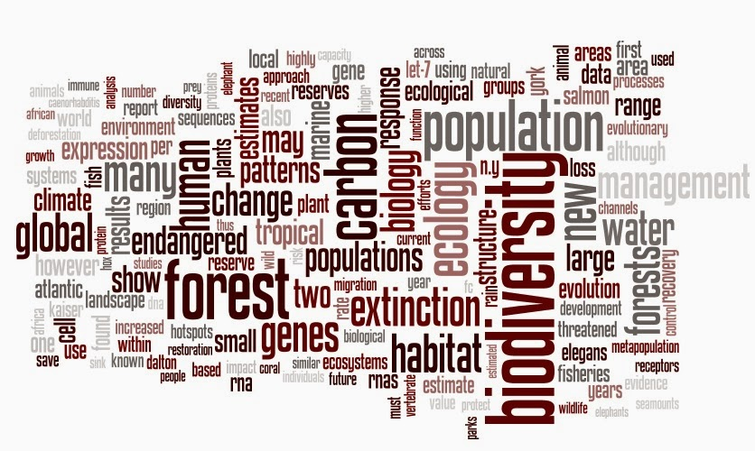
DISCUSSION SESSION
THANK YOU!!

