Slide 1
The 2030 Agenda and SDGs and the role of SAIs
15th SC Meeting of the WGEA
Washington DC, 13 Sept. 2017
Aránzazu Guillán Montero
UNDESA/DPADM
Notes:
http://www.UNPAN.org/DPADM/
Division for Public Administration and Development Management
1
1

Slide 2
A results framework – The SDGs
Notes:
We are in the second year of implementation of the 2030 Agenda for Sustainable Development, which was adopted at the United Nations Summit in September 2015.
The 2030 Agenda calls on all people and a renewed partnership to ending poverty and enjoying universal access to essential services and infrastructure, ensuring peaceful, inclusive and sustainable societies.
The 17 SDGs and their 169 targets are at the heart of the 2030 Agenda. They are a detailed set of goals and targets to ”transform our world” by 2030.
Achieving these goals will require integrated action on social, environmental and economic challenges, with a focus on inclusive, participatory development that leaves no one behind.

Slide 3
The 2030 Agenda is underway
Adoption of the 2030 Agenda on September 25th 2015 as a result of a participatory process.
Related frameworks:
Sendai Framework for Disaster Reduction (June ‘15)
Addis Ababa Action Agenda (July ‘15), which commits to “strengthen national control mechanisms, such as SAIs”.
Paris Climate Agreement (Dec. ‘15).
SDG Global Indicator Framework endorsed by UN SC in March 2016, by ECOSOC on 7 June 2017 and approved by General Assembly on 6 July 2017 – indicators to be reviewed and refined annually and comprehensively in 2020 and 2025 .
Global Follow-Up and Review architecture defined by UNGA/Guidelines for voluntary review.
HLPF of SDGs era:
22 countries presented their VNRs in 2016; 43 countries in 2017; and 44 have already volunteered for 2018.
Notes:
The Agenda is well underway
Adoption of the 2030 Agenda on September 25th 2015 as a result of a participatory process.
Related frameworks:
Sendai Framework for Disaster Reduction (June ‘15)
Addis Ababa Action Agenda (July ‘15), which commits to “strengthen national control mechanisms, such as SAIs”.
Paris Climate Agreement (Dec. ‘15).
SDG Global Indicator Framework endorsed by UN SC in March 2016, by ECOSOC on 7 June 2017 and approved by General Assembly on 6 July 2017 – indicators to be reviewed and refined annually and comprehensively in 2020 and 2025 .
Global Follow-Up and Review architecture defined by UN SG.
HLPF of SDGs era:
22 countries presented their VNRs in 2016; 43 countries in 2017; and 44 have already volunteered for 2018. TOTAL OF 109 COUNTRIES

Slide 4
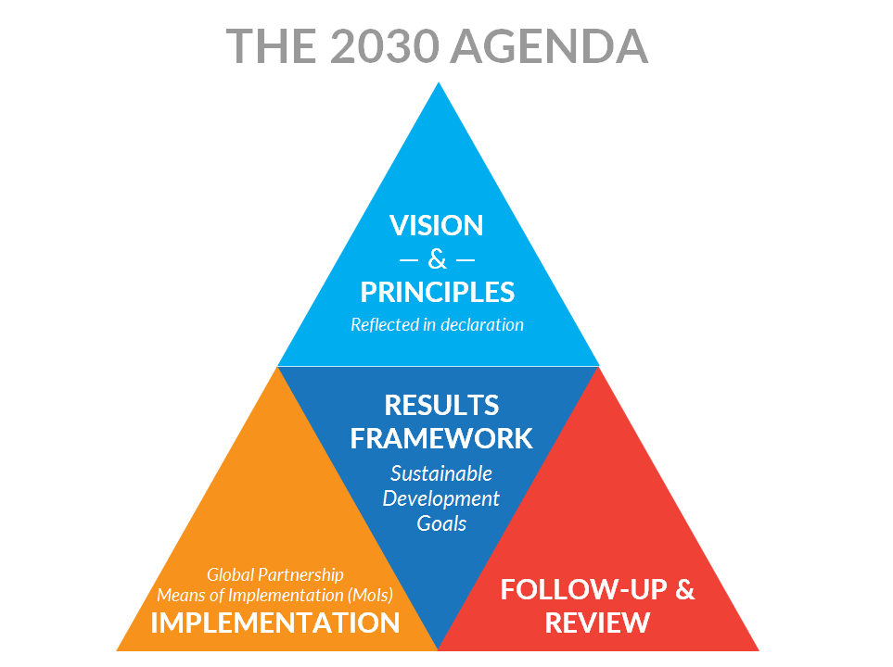
Structure of the 2030 Agenda
Notes:
Before providing some information on where we stand in year 2, I would like very briefly to highlight /remind ourselves of some key characteristics of the 2030 Agenda.
1) Scope. Ambitious and comprehensive. The 2030 Agenda provides a comprehensive and transformative blueprint for “transforming the world by 2030”.
It calls for ambitious measures related to 5 themes: people, the planet, prosperity, peace, and partnership. It considers the interdependence between the environmental, social and economic dimensions.
New issues not included in MDGs
2) Structure: global agenda which integrates a Results framework (SDGs) with a vision and principles on sustainable development; an implementation strategy; and a follow-up and review framework.
3) Key principles:
Universality
Rests on a set of universal principles, values and standards, which are applicable in all countries, in all contexts and circumstances and at all times. Sustainable development involves all countries, developed and developing, rich and poor.
National ownership
The SDGs are global targets that should be adapted through national processes to national circumstances. Each country must define national targets based on national priorities.
Human rights
The SDGs explicitly “seek to realise the human rights of all”. Several SDG targets directly refer to human rights, to specific rights and/or include references to ensuring equal access for different groups, universal access to public services, universal health coverage for all, free, equitable and quality education, and social, economic and political inclusion, among others.
Integrated
Different dimensions of development are interconnected. The Agenda is all-encompassing and interconnected in all its dimensions and at all levels: between goals, between countries, and between global, regional and national levels. The Agenda commits to an integrated and balanced approach to achieve sustainable development.
People-centered, gender sensitive, leave no one behind
Calls for reaching the furthest first and emphasizes the need of addressing all forms of inequality and discrimination. It aims to ensure the inclusion of marginalized, excluded and disempowered groups and to reduce inequalities within and between States.
Inclusive and participatory
Highlights the importance of national participatory processes to ensure meaningful and active participation of stakeholders at all stages, from integration into national strategies, to implementation, to national monitoring and review.
Global solidarity and partnerships
It implicates all countries and all people in an inclusive and collective effort for sustainable development. This underscores the idea of the 2030 Agenda as a global partnership for sustainable development.
FOLLOW UP and REVIEW
In contrast to the Millennium Development Goals (MDGs), the 2030 Agenda includes detailed provisions for follow-up and review.
It encourages countries to monitor results and conduct regular reviews of progress.
The bedrock of accountability is the national level. This is where the main role of SAIs is.
But the country-level reviews will inform Voluntary National Reviews (VNR) at the High Level Political Forum (HLPF).
→ GLOBAL FOLLOW-UP and REVIEW PROCESS

Slide 5
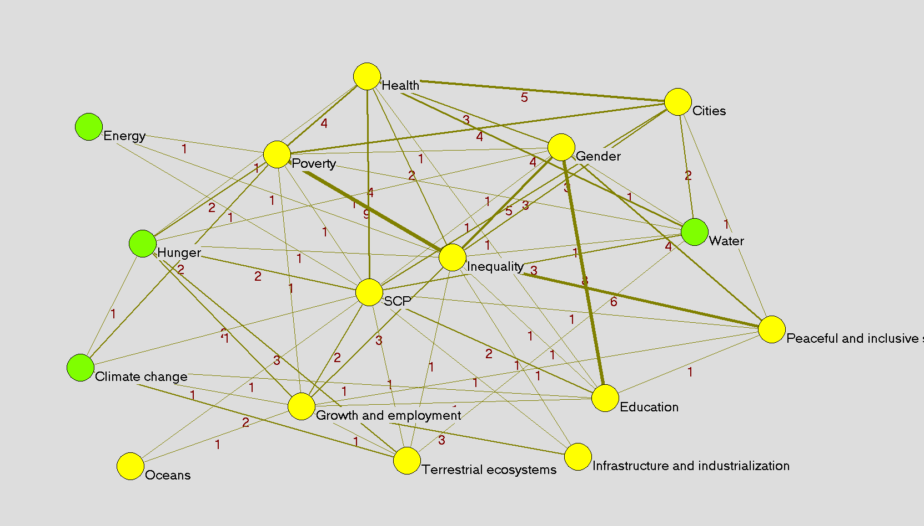
Integrated: a network of targets
Source: D. Le Blanc. “Towards integration at last? The sustainable developent goals as a network of targets
Notes:
Sustainable development issues are interlinked in many different ways
This has been recognized for a long time
The SDGs, in contrast with their predecessors the MDGs, explicitly recognize this
Example: under SDG 12, “Ensure sustainable consumption and production patterns”, target 12.4 states: “by 2020 achieve environmentally sound management of chemicals and all wastes …. to minimize their adverse impacts on human health and the environment”.
Because of this, the SDGs can be seen as a network of interlinked goals and targets
The SDGs do not (by far) reflect all the links that matter for decision-making at different levels…
…but they can help promote system thinking and integrated approaches

Slide 6
Implementing the 2030 Agenda
Building awareness and dissemination
Relate 2030 Agenda to country demands and priorities
Engaging multiple stakeholders
Ensure legitimacy, include different perspectives and create partnerships for implementation
Tailoring SDGs to national, subnational and local contexts and setting priorities
Integrate SDGs in planning and policy processes (not a separate agenda)
Creating horizontal and vertical policy coherence (sectors and levels of government)
Identifying and mobilizing resources
Monitoring, review and reporting
Develop integrated policy solutions that involve different sectors and levels of government and public administration
Ensure resources (different sources) and necessary capacities for implementation (technology, data, etc.)
Measure progress towards the achievement of SDGs and ensure accountability for performance and results
Source: UNDG (2017) Mainstreaming the 2030 Agenda for Sustainable Development

Slide 7
Countries moving ahead with implementation
Progress is evident, but its rate in some areas is slower than needed to meet the targets by 2030 (SDG Report 2017):
Reducing poverty, hunger and malnutrition, and addressing inequality, as overarching challenges—with negative trends in some regions
The negative impact of environmental stressors (e.g., on health, natural disasters), particularly on women, expected to grow unless action is taken
Lack of official statistics, data and effective monitoring systems as important challenges
HLPF / VNR show extensive national preparations and strong commitment of national governments:
Internalizing SDGs into development strategies and planning processes (e.g., Uganda, Indonesia)
Setting coordination mechanisms
Enhancing the alignment of budgets and policy making
Strengthening evidence and science-based policy making
Notes:
The VNR provide information on ongoing efforts to implement the Agenda, and the related challenges.
Many countries are adapting the targets and incorporating them in their national development plans and strategies.
A first step they take is often to adjust their institutions.

Slide 8
Countries moving ahead with implementation
Leveraging inter-linkages between SDG targets requires leadership and improved policy coherence and coordination through WoG approaches (e.g., Finland) –institutional arrangements for SDG implementation:
Countries are creating new entities (e.g., Colombia), leveraging existing institutional frameworks for SD (e.g., Germany), relying on the leadership of key ministries (e.g., Norway).
Need to translate interlinkages into policy-making, budgeting and institutional structures.
Aligning budgets (e.g., Mexico, Norway)
Tools: mapping of inter-linkages, institutions and programmes, and stakeholders (e.g., Sri Lanka).
Need to create incentives for enhancing the engagement of sub-national and local authorities.
Gaps remain in engaging Parliaments, which are however proactively mobilizing around SDGs in several countries through oversight functions (e.g., Finland), specialized committees (e.g., Fiji), special advisory groups (e.g., Germany).
Notes:
Creation of new coordination entities:
• Bangladesh has established an Inter-ministerial Committee on SDG Monitoring and Implementation chaired by the Principal Secretary to the Prime Minister;
• Colombia has created a High-level Inter-ministerial Commission for the preparation and effective implementation of the post-2015 development agenda and its sustainable development goals (ODS Commission) chaired by the National Planning Department with ministerial level representation across the government;
• Ghana has established a High-Level Inter-ministerial Coordinating Committee comprised of Ministers and Directors from 11 ministries and agencies under the supervision of the President;
• The Philippines is planning to create an Inter-Ministerial Committee to be chaired by the President and led by National Economic Development Authority;
Using or adjusting existing structures:
• In Estonia, an inter-ministerial working group on sustainable development in involved in coordination of SDG implementation. The group is chaired by its Government Office, which leads SDG implementation in the country;
• Ethiopia has a National Planning Commission chaired by its Prime Minister and comprised of cabinet ministers, chief executives of regional states, among others;
• In Germany, the SDG implementation strategy is being driven by a high-level State Secretaries’ Committee for sustainable development - headed by the Chancellery with representation from all Federal ministries.
Leading Ministries
In Norway, the Ministry of Finance is currently in charge of promoting implementation, while there is an on-going discussion on the possible creation of a new inter-ministerial coordination structure;
• In Uganda, the Ministry of Finance, Planning and Economic Development is leading the way.
Involving local authorities
Spain: The Basque and Catalan regional governments are drafting SDG implementation strategies
Finland is open for new participatory arrangements as needed, so as to reach out to sub-national government levels and to ordinary citizens;
Germany is establishing engagement through organised local government organizations;

Slide 9
Countries moving ahead with implementation
Multi-stakeholder engagement is increasing and changing in nature:
Importance of bringing all stakeholders (including new actors) though joint multi-stakeholder whole of society approaches (e.g., Finland).
Participation takes place through institutionalized mechanisms—VNRs, SDG implementation entities, etc. (e.g., Brazil).
Need of strengthening coordination and communication with non-government stakeholders.
Monitoring frameworks:
Need to integrate M&E structures into single national systems to reduce overlaps and parallel structures.
Localizing targets and indicators is critical.
Countries are exploring different M&E institutional arrangements such as new inter-agency structures (e.g., Georgia) or specialised units (e.g., Moldova).
Most countries rely on National Statistical Offices (NSO) for SDG monitoring but they need enhanced capacities and coordination with other actors.
Importance of addressing capacity gaps and investing in data collection, disaggregation and analysis.

Slide 10
SAIs’ commitment to support 2030 Agenda
1
2
3
4
Auditing preparedness and national systems of follow-up
Performance audits on programmes that contribute to SDGs
Assessing and supporting SDG 16
Being model of transparency and accountability
INTOSAI Strategic Plan 2017-22: “Contributing to the follow-up and review of the SDGs within the context of each nation’s specific sustainable development efforts and SAIs’ individual mandates”
XXII INCOSAI – Abu Dhabi Declaration: Commitment to making a meaningful independent audit contribution to the 2030 Agenda
Guidance and support for SAIs in their contribution to SDGs
Frameworks for production of high-quality information under 4 approaches to share with internal and external audiences
Opportunities for capacity enhancement and knowledge sharing- IDI
Notes:
In its Strategic Plan 2017-22, INTOSAI has identified four approaches through which SAIs can contribute to the SDGs:
Assessing national readiness for implementing the SDGs and reporting progress towards the targets.
Auditing the performance of government programs that contribute to the SDGs.
Assessing and supporting the implementation of SDG 16, including budgetary commitments and transparency and helping fight against corruption.
Being models of transparency, integrity and accountability in their own operations.
XXII INCOSAI – Abu Dhabi Declaration
Commitment to making a meaningful independent audit contribution to the 2030 Agenda for Sustainable Development.
With this framework in place, you are now working to advance these approaches and to embed them within INTOSAI processes and structures.
You are discussing implementation frameworks and specific milestones. And you are promoting communities of practice that can support knowledge-sharing and help develop SAIs’ capacities.
You are also considering specific ways of aggregating information and reporting to the INTOSAI community and external partners on the results of SDG audits in a way that can also inform the SDG review at the global level.
SAIs
Advice, assurance and assessment of preparedness, implementation and monitoring and reporting on SDGs
Financial, compliance and performance audits, opinions and reviews
Transparency, participation and accountability in its operations

Slide 11
SAIs are making significant progress
Some SAIs have included SDGs into their strategic plan (e.g., Bhutan) or are considering to do it (e.g., Sierra Leone)
SAIs are conducting audits of how governments have prepared for SDG implementation (e.g., Austria, Brazil, Canada, ARABOSAI)
SAIs are contributing to follow-up and review (e.g., Brazil’s TCU was part of the official delegation to the HLPF and contributed to the VNR)
SAIs are conducting audits in SDG areas (e.g., Jamaica on energy, UAE on health indicators)
SAI Sudan is working with Parliament to enhance auditors’ capacity to audit SDGs
At regional level, 11 SAIs in OLACEFS are conducting a cooperative audit of Target 2.4 on food security
IDI-KSC programme on “Auditing SDGs” is underway:
Guidance on auditing preparedness for SDG implementation
eLearning course for 44 English-speaking SAIs underway; 14 SAIs in OLACEFS starting in Sept. with focus on SDG5; CREFIAF and ARABOSAI in early 2018
Audits to be conducted in 2018
Compendium of good practices

Slide 12
Multiple opportunities
Recognition of the role of SAIs (UN resolutions, AAAA) and INTOSAI strategic direction.
SAIs are part of the SDG implementation and follow-up and review ecosystem at the national level - Proactively reach out to government and stakeholders to inquire about SDG implementation and to advocate SAI role.
Clear value of SDG audits (e.g., auditing MoI and use of resources; auditing preparedness to provide baselines for reviewing implementation).
Adoption of WoG approach by governments provides opportunities for new audit methodologies and approaches to assess governance complexity.
SAIs have accumulated experience – “auditing SDGs w/o knowing it”.
Contribution to SDG follow-up and review at different levels:
National: Each country decides how to review and report on progress. Government can decide to engage the SAI. SAIs could advocate role and engage with stakeholders to contribute to national reviews.
Regional: Collaboration with UN Regional Commissions and regional mechanisms.
Global: SAIs could contribute to the VNRs in different forms. Through INTOSAI, provide inputs to the HLPF on progress towards the SDGs from the SAI perspective.
Notes:
UN Resolutions recognise the important role of SAIs and their contribution to sustainable development.
A/66/209 (2011)
A/69/228 (2014)
A/69/327 (2015)
International Standards SAI (ISSAI)
ISSAI 12 – Value and benefits of SAIs – making a difference to the lives of citizens
SAIs are at the core of effective, accountable and inclusive institutions. They can promote the accountability of all stakeholders in translating the new Agenda into positive change across the world.
SAIs can oversee the integration of the Agenda into national frameworks.
They can review the performance of programmes to achieve the SDGs.
They can look at issues related to data collection capacities, monitoring systems and budget allocations.
It is important to engage in a dialogue about the ways SAIs can contribute to national reviews in your own countries and in meetings such as today’s.
On our part, we are highlighting the commitment of SAIs in all our meetings. We believe lessons and messages from your collective work can also make a great contribution to UN meetings.

Slide 13
Follow-up and review at global level -HLPF
National voluntary presentations: with or without national indicators
High-level Political Forum (HLPF)
SDG Progress Report (annual)
Global Sustainable Development Report (GSDR) (4 years)
Financing for Development Forum: Additional indicators on FFD
Thematic/Goal reviews: based on thematic indicators
National SDG reports:
Based on national indicators
Regional reviews:
Based on regional and/or global indicators
Notes:
HLPF is the Central platform for SDG follow-up and review
Under the auspices of ECOSOC
Annual
VNR & Thematic reviews
Inclusive of UN entities, civil society, private sector and other stakeholders
Under the auspices of GA
Every four years (Sept. 2019)
Heads of State and Government
Political guidance on A2030 and its implementation
Timeline for the HLPF
2019
Empowering people and ensuring inclusiveness and equality
SDG sdg4
SDG sdg8
SDG sdg10
SDG sdg13 CLIMATE ACTION (audit guidance on climate change)
SDG sdg16
SDG sdg17
2018
Transformation towards sustainable and resilient societies
SDG sdg6 WATER AND SANITATION
SDG sdg7 ENERGY
SDG sdg11 SUSTAINABLE CITIES (Greening cities, Air pollution)
SDG sdg12
SDG sdg15 LIFE ON LAND (Biodiversity, Land organisation)
SDG sdg17
2017
Eradicating poverty and promoting prosperity in a changing world
SDG sdg1
SDG sdg2 ZERO HUNGER
SDG sdg3
SDG sdg5
SDG sdg9
SDG sdg14 LIFE BELOW WATER
SDG sdg17
2016
Ensuring that no one is left behind

Slide 14
But also some challenges
Low awareness of SDGs in government, SAIs and society.
SAIs have different mandates (e.g., performance audit) – reflect on different roles, responsibilities and contributions.
Distinctiveness of auditing SDGs – new approaches require enhanced capacities and resources:
Examine complexity and interconnections - SDG audits have to look at the interconnections between goals and targets. This requires a focus on outcomes and examining interconnected and boundary spanning issues instead of looking at individual programmes, projects and agencies as silos.
Wide stakeholder engagement in the audit process - SAIs have to look beyond traditional mechanisms of collecting evidence and consult with a wider set of stakeholders throughout the audit process, while preventing bias and preserving independence.
Focus on inclusiveness - expand traditional effectiveness questions to ask about issues of inclusiveness and how these have been met.
Audit performance information - When auditing SDG implementation, SAIs need to look at performance information and develop capacity and approaches for auditing performance information and performance measurement systems.
Availability, quality and credibility of disaggregated data and how to leverage data tools.
Notes:
Responding to the complexity of the SDGs requires SAIs to respond flexibly and in ways that go beyond their traditional mandate.
I would like to highlight a few challenges:
xxx
Inclusiveness – Example: how the impact of climate change on women is being addressed by governments in their implementation plans

Slide 15
Final reflections
Importance of taking a strategic approach to engaging with SDGs (value of SDG audits, outputs, capacities needed).
Extensive scope of the 2030 Agenda requires prioritizing SDG audits:
Not all SDGs at once: preparedness; government plans and objectives; risks that government objectives not achieved; VNR process; sets of SDGs (based on context and SAI priorities)
Embedding a sustainable development perspective into environmental auditing:
Integrated approach and SDG inter-linkages – selection (e.g., programs with integrated approach; sets of interlinked SDGs), conducting (e.g., social and economic dimensions)
Showing and effectively communicating results:
Aggregation of findings to provide inputs into follow-up and review processes – Who? How?
To whom? - Communicate to different audiences to show relevance, trigger remedial action and enhance trust and credibility
Importance of partnerships and collaboration
Enhancing SAI capacity by leveraging knowledge-sharing and cooperative approaches.
Notes:
Importance of taking a strategic approach to engaging with SDGs (value of SDG audits, outputs, capacities needed).
THIS APPLIES NOT ONLY TO INDIVIDUAL SAIS BUT ALSO TO INTOSAI WG LIKE WGEA
Extensive scope of the 2030 Agenda requires prioritizing SDG audits:
Not all SDGs at once: preparedness; government plans and objectives; risks that government objectives not achieved; VNR process; sets of SDGs (based on context and SAI priorities)
IMPORTANT TO CONSIDER
WHAT GOVERNMENTS ARE DOING FOR SDG IMPLEMENTATION IN YOUR RESPECTIVE COUNTRIES
BUT FROM THE PERSPECTIVE OF WGEA, WHEN SETTING WORK PLANS AND STRATEGIES
CONSIDER INTERLINKAGES BETWEEN THE DIFFERENT INTOSAI APPROACHES – THESE ARE NOT SEPARATE BOXES
CONSIDER REGIONAL AND GLOBAL PROCESSES AND HOW TO ALIGN WITH THOSE PROCESSES
TIMELINE OF THE HLPF AS AN IMPORTANT REFERENT
SDG 15 ON TERRESTRIAL ECOSYSTEMS AND LAND FOR EXAMPLE TO BE REVIEWED IN 2018 AND SDG 13 ON CLIMATE ACTION IN 2019
Embedding a sustainable development perspective into environmental auditing:
Integrated approach and SDG inter-linkages – selection (e.g., programs with integrated approach; sets of interlinked SDGs), conducting (e.g., social and economic dimensions)
INITIATIVE TO DEVELOP THE AUDIT GUIDELINE IS VERY VALUABLE
HOWEVER, ALSO RISK OF CREATING SILOS
MAINSTREAM/INTEGRATE THE SUSTAINABLE DEVELOPMENT PERSPECTIVE INTO THE DIFFERENT ACTIVITIES OF THE WGEA – HOW TO BRING THIS PERSPECTIVE AND APPROACH INTO OTHER PROJECTS AND INITIATIVES
Showing and effectively communicating results:
Aggregation of findings to provide inputs into follow-up and review processes – Who? How?
REFLECT ON THE ROLE OF WGEA AND/OR INDIVIDUAL SAI MEMBERS
To whom? Communicate to different audiences to show relevance, trigger remedial action and enhance trust and credibility
IMPORTANCE OF GOING BEYOND THE SAI COMMUNITY –
GIVE VISIBILITY TO THE WORK SAIS ARE DOING
Importance of partnerships and collaboration
REFLECT ON HOW TO ENGAGE WITH EXTERNAL ACTORS
Enhancing SAI capacity by leveraging knowledge-sharing and cooperative approaches.
VERY GOOD EXPERIENCES IN INTOSAI COMMUNITY TO BUILD ON
NEED TO CONTINUE
[final]
DESA and my Division are committed to working closely with INTOSAI to support SAIs’ contributions to the review of the SDGs at different levels.
We are also committed to help strengthen the capacity of SAIs for enhancing accountability in the implementation of the 2030 Agenda.
We are collaborating with the INTOSAI Chair and the Secretariat on the four approaches.
We are also working with the INTOSAI Knowledge Sharing Committee (KSC), the INTOSAI Development Initiative (IDI), INTOSAI Regions and other partners in a capacity development program on “Auditing the SDGs.”
We look forward to working closely with INTOSAI Working Groups and its members to support the contributions of SAIs to the review of the SDGs and to advance the role of SAIs in sustainable development.
Thank you.

