Slide 1
Training on Environmental Auditing in the Global Training Facility
SAI India

Slide 2
Background:
SAIs throughout the world have perceived strong need for trainings in Environmental Audit as has been observed through various surveys conducted by INTOSAI WGEA.
10th Meeting of WGEA SC held at Marrakech, Morocco ( March 2011 – decision to merge training material available worldwide and conduct a combined environmental audit training course at Global Training Facility (GTF) i.e. International Centre for Environment Audit and Sustainable Development (iCED), Jaipur (INDIA)
Work Plan – 2014-16: Project leaders -SAIs of Estonia, India, Indonesia
Work Plan–2017-19: Project leader - SAI India with active support from SC, SAI Cameroon, SAI Lesotho, SAI South Africa

Slide 3
Project objectives and outcomes
iCED continues to shoulder the responsibility of GTF for WGEA in its Work Plan 2017-19 with the following objectives:
Review of the existing modules of environmental auditing training course for beginners – ‘Introduction to Environmental Audit’
Organise the training programme ‘Introduction to Environmental Audit’ in all three years targeting those who may have done basic courses (like Massive Open Online Courses (MOOCs) courses developed by the National Audit Office of Estonia, in cooperation with University of Tartu) or those keenly interested
Progressively address interaction needs at managerial level through training-cum-workshops on audit of specific environmental issue like water, waste, etc.
Ensure collaboration with various SAIs in review / design of training programmes as well as delivery of the same

Slide 4
Planned Methodology: Highlights
Building on WGEA research
Drawing upon recent developments and practices regarding environmental audits
Using case studies reported by SAIs
The project leader will give regular updates on the progress of the project, as per indicative timeline and deliver a practical high quality training.
The WGEA Steering Committee members and other three subcommittee members are expected to be key contributors in this project.

Slide 5
Timeline
Sr | Action | Date
1 | 15th SC, review and approval of the Session Plans | September 2017
2 | Final versions of the Session Plans ready for delivery | 30 Sept. 2017
3 | Conduct of training on Introduction to Environmental Auditing | Nov.– Dec. in 2017 / 2018 / 2019
4 | Conduct of training-cum-workshop on Audit of Water Issues (originally proposed for October/ November 2017) | Jan 2018
5 | Participants feedback summary on both trainings to be shared with Steering Committee / sub-committee members | Jan. 2018
6 | Responses from Steering Committee / subcommittee members | Feb / March 2018
7 | Experience sharing with the Assembly at 18th WGEA Assembly | March 2018
8 | Draft Session Plans of training programme on audit of other two specific environmental issue (Waste Issues, Biodiversity) to be shared with Steering Committee / subcommittee members | April – May 2018
9 | Comments from the Steering and subcommittee members | June – July 2018
10 | Final Session Plans to be circulated to SC and Sub-committee members | July 2018
11 | 16th SC meeting, review and approval of the Session Plans and final versions of the Session Plans ready for delivery | November 2018
12 | Conduct of training / training-cum-workshop on Audit of Waste Issues | Dec. 2018 – Jan. 2019
13 | 19th WGEA Assembly presentation of all the work done as GTF | September 2019
14 | Conduct of training / training-cum-workshop on Audit of Biodiversity | Oct.– Nov. 2019

Slide 6
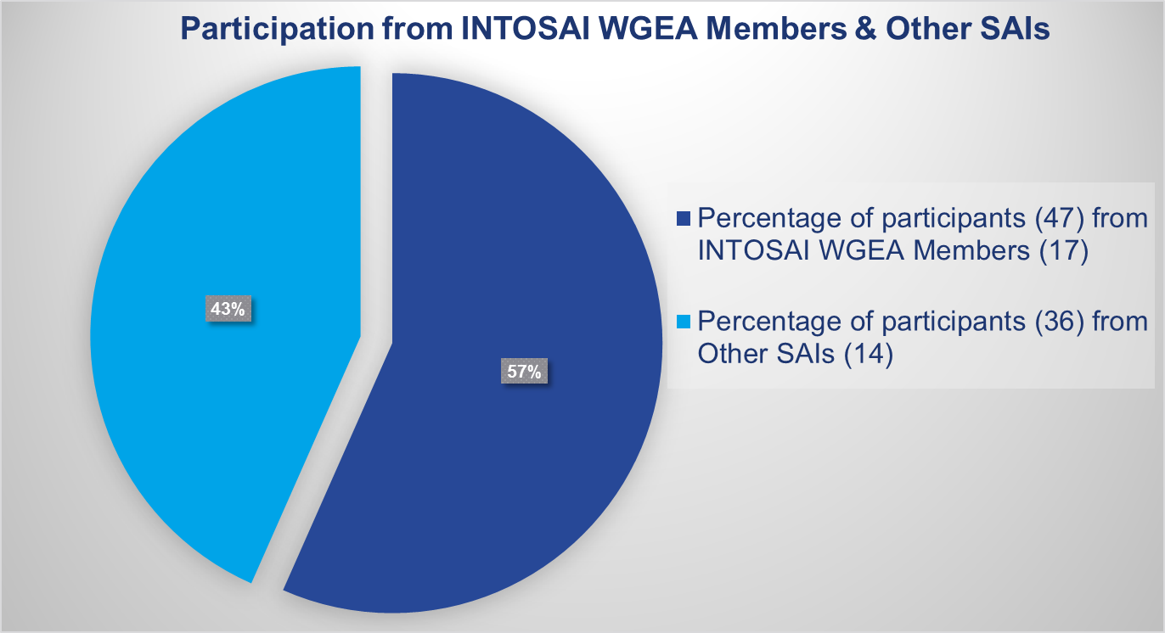
Learning from previous experience…….. Participation proportion of INTOSAI WGEA Member SAIs in 4 ITPs so far

Slide 7
Feedback during WP 2014 - 2016
Feedback has been collected from the participants on
the trainers / specific training sessions
course structure.
Trainers rating : > 8 on a scale of 0 – 10
Course structure/ contents - quite interesting and helpful
Mix of classroom teaching, field visits/ study trips - Right (specifically appreciated)
Participants overall perception - appropriate platform to share best practices in their country

Slide 8
Initial ITP Course Development & Delivery
Unique feature of ITP on Environment Auditing – Course module developed and delivered through collaborative efforts of SAIs.
A project sub-committee comprising of SAIs of Estonia, Finland, India, Norway, US developed the outline, including programme structure and session-of-the- glances of the training programme.
SAI of Brazil later joined the sub­committee to develop biodiversity module.
SAI Tanzania and SAI, Lesotho also volunteered to contribute.
SAI, New Zealand peer reviewed some of the training material.

Slide 9
Contribution of Trainers
S. No. | Module | 1st ITP | 2nd ITP | 3rd ITP | 4th ITP
1. | Environment Audit | SAI, Estonia | SAI, Estonia | SAI, Estonia | SAI, Estonia
2. | Water | SAI, Estonia and SAI, India | SAI, Indonesia | SAI, Indonesia | SAI, Indonesia
3. | Biodiversity | SAI, Brazil | SAI, Brazil | SAI, Brazil | SAI, India
4. | Waste | SAI, India | SAI, India | SAI, India | SAI, India
5. | Climate Change | SAI, Norway | SAI, Estonia and SAI, India | PASAI and SAI, Micronesia | SAI, India and ECA

Slide 10
Course Review
Intended to
Enrich course content
Update to include current developments in technology
Bring in an element of sensitising auditors to SAI greening
Include new auditing techniques, global enviro-legal framework, international agreements, etc.
Suggestions including inputs on length and content of the course module as well as any additions/ deletions were invited from SAIs
Comments received from SC and subcommittee members would be progressively factored in course design each year

Slide 11
Forthcoming ITP
Following changes have been made in the Course structure w. e. f. from the 5th ITP on Introduction to Environment Auditing to be held at iCED from 20th Nov. to 02nd Dec., 2017:
Duration of the course has been reduced from 15 to 12 days by restructuring and consolidation
Following sessions have been added:
“Greening SAIs”
“Market Based Instruments in Environmental Governance”
“SDGs” and “Audit of SDGs”
“Environmental Assessments and its Audit”
“Renewable Energy and Energy Efficiency” and “Audit of Renewable Energy and Energy Efficiency”
Session on Introduction to Auditing, Performance Audit has been removed as all of the participants attending training program are aware of basics (some may have undergone MOOCs, etc.).

Slide 12
Nominations for the 5th ITP (as on 5.9.2017)
S. No. | SAI | INTOSAI WGEA Member/ Other SAI | Expected Number of participants
1. | Bangladesh* | INTOSAI WGEA Members | 2
2. | Bhutan |  | 1
3. | ECA |  | 1
4. | India |  | 2
5. | Saudi Arabia |  | 2
6. | Thailand |  | 1
7. | Zambia |  | 2
8. | Botswana | Others | 1
9. | Fiji |  | 1
10. | Nepal* |  | 1
11. | Philippines* |  | 1
12. | Vietnam* |  | 2
TOTAL |  |  | 17
*Participating for the first time in ITP on Introduction to Environment Auditing at iCED

Slide 13
Trainers Support for 5th ITP (Contd..)
SAIs attending this meeting are also requested contribute trainers for the 5th ITP. Based on contribution of Audit reports on specific subjects/ INTOSAI WGEA Research Projects, SAIs can volunteer to contribute trainer/s:
S.No. | Module/ Session | Tentative dates for the module/ session (excluding transit time)
1. | Environmental Governance, Market Based Instruments and Environment Audit | 20th November to 23rd November, 2017
2. | Sustainable Development Goals | 21st November to 22nd November, 2017
3. | Water | 23rd November to 24th November, 2017
4. | Climate Change | 24th November to 25th November, 2017
5. | Biodiversity | 25th November to 28th November, 2017
6. | Environmental Assessments | 29th November, 2017
7. | Renewable Energy and Energy Efficiency | 29th November to 30th November, 2017
8. | Waste | 30th November to 01st December, 2017

Slide 14
ITP on Audit of Specific issues
While designating iCED as GTF on Environment Auditing it was envisaged to conduct a general introductory training programme on Environment Audit initially and later move on to more specific training programmes on specific topics later on.
Additional international training programme on specific issue was proposed in the 14th SC meeting, while deliberating on Work Plan 2017 – 19.
The subject specific training-cum-workshop could be a five day programme on a specific environmental issue.
Proposal (dates revised considering comments on project plan) included following training programmes to be conducted during 2016 to 2019:
Year | Subject
Jan 2018 | Water
Jan 2019 | Waste

Slide 15
ITP on Audit of Specific issues
5 day ITP on Audit of Water issues was planned to be conducted in October, 2017.
Proposal was circulated among the SC members, seeking suggestions / feedback, faculty support etc.
SAI, Lesotho has offered suggestions. Views of other SC members awaited.
All the SC members are requested to provided feedback / suggestions on the format and structure of training programme so as to ensure wider participation.

Slide 16
Other International Events at iCED
iCED also hosted 6th Seminar on Environmental Auditing and the 5th Working Meeting of ASOSAI WGEA in October, 2016 – 21 SAIs (48 participants)
iCED has conducted Bilateral Training Programmes for some of the SAIs based on their requests.
S.No. | SAI | Number of Training Programmes conducted so far
1. | Afghanistan | 2
2. | Bangladesh | 1
3. | Bhutan | 1
4. | Oman | 3

Slide 17
Some important developments
iCED will also host of audit planning meeting and preparatory meeting for IDI-KSC program on performance audit of preparedness for implementation of SDGs in December, 2017
iCED has been tasked to be a nodal centre for national information collection for audit of SDGs in India
iCED held a national seminar in June 2017 on “Assessing preparedness to achieve SDGs in India
iCED has offered to host curriculum development for global training for INTOSAI WGEI

Slide 18
Contacts
Contacts at iCED -
Sunil Dadhe,
Director General, iCED
dadhess@cag.gov.in / dgiced@cag.gov.in
+91 141 2772009 +91 9422517982
Jahangir Inamdar,
Director (T&R), iCED
inamdarJ@cag.gov.in / iced@cag.gov.in
+91 141 2772002,+91 9867085464
SC members :-
May kindly indicate individual contact persons.

Slide 19
…… kindly watch a small video on iCED – INTOSAI WGEA’s Global Training Facility
THANK YOU

