Slide 1
Climate –Water Nexus in Africa Drinking water, droughts and desertification
Current State
Trends/Predictions
Impact (Social Economic Environmental)
Response Strategies

Slide 2
Status (Drinking Water)
2nd most populous continent after Asia 1.5 Bio
2nd driest continent globally after Australia
Water emergency in Africa mainly climate-induced (pollution, poor management, deforestation, limited water resources, conflict)
1 in 3 Africans affected by water scarcity. According to the 2022 411 million people in Africa still lack basic drinking water service, 779 million lack access to basic sanitation services, and 839 million lack access to basic hygiene (WHO/UNICEF JMP 2022 report),
Currently about 42% of the population in the African Great Lakes region does not have access to basic drinking water

Slide 3
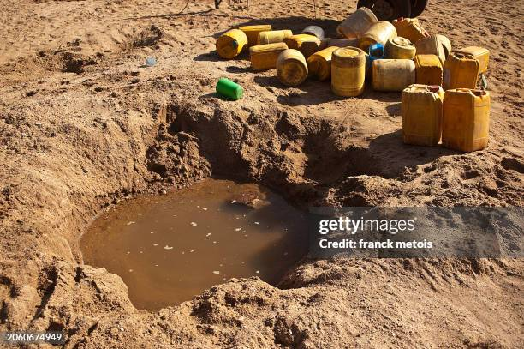
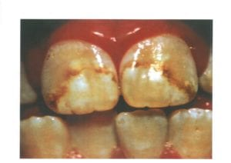
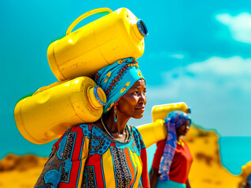
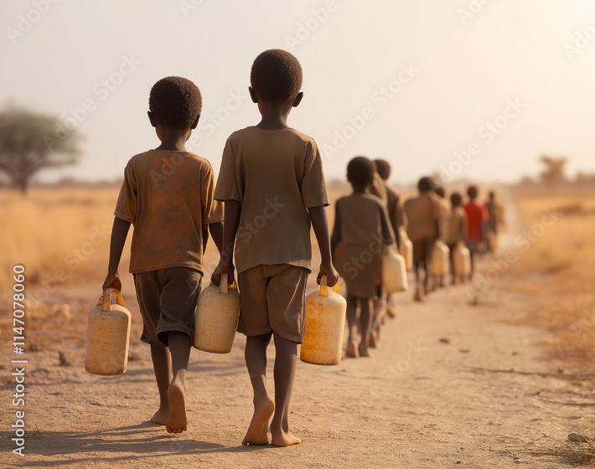
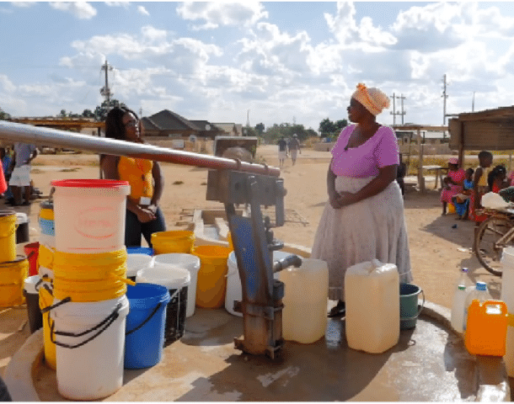

Slide 4
Status (drought & desertification)
2/3 of Africa are ASALs,5.52/7.78 billion in 186 countries face water insecurity of which 1.34 billion are Africans, despite Africa possessing 9% of global freshwater resources

Slide 5
Worst droughts in Africa (severity, human impact, duration)
Drought Phenomenon | Countries Affected
Sahel drought 1968-1974 | Senegal, Mauritania, Mali, Burkina Faso, Niger, Nigeria, Chad, and Sudan. IMPACT: deadliest droughts in modern African history, it caused widespread famine and the deaths of over 100,000 people. Millions were displaced due to crop failures and livestock deaths
Ethiopia drought 1983-1985 | Ethiopia IMPACT: catastrophic famine that killed an estimated 400,000 to 1 million people. It gained global attention and led to international relief effort
Eastern Africa | Somalia, Ethiopia, Kenya, and Djibouti IMPACT: Over 13 million people were affected. Somalia was hit hardest, with famine declared in several regions. The crisis was worsened by conflict and displacement
Southern Africa 2018-2021 | Zambia, Zimbabwe, Mozambique & others IMPACT: food & water scarcity
Horn of Africa 2022-2023 | Somalia, Ethiopia, Kenya IMPACT: worst drought in 40 years, with five consecutive failed rainy seasons. Over 23 million people faced severe hunger, and millions were displaced

Slide 6
Trends
Droughts are projected to worsen in sub-Saharan Africa due to climate change, further threatening agricultural production and food security.
Reduced river flows are expected to persist, affecting agriculture, ecosystems, and hydropower

Slide 7
Impact
Social | Food and water insecurity Health (Malnutrition, water borne diseases e.g. cholera, typhoid, drought and meningitis) Displacement & family disintegration Gender Aspects: Gender based violence, burden on women & girls
Economic | Energy : Hydropower generation e.g. Zambia/Zimbabwe Lake Kariba Industry: (agric. raw materials – leather, oils for Agricultural Commodity dependent economies) GDP and Rainfall correlation – primary sectors Rise in prices of food, water…..
Environmental | Pressure on groundwater resources (quality, impact on water table), vegetation stress e.g. Zambezi Valley, North Africa Soil degradation including salinization Pollution Air quality

Slide 8
Africa Climate Summit
Africa Climate Summit (ACS2 in Sept 2025)
Recognized Water Crisis in Africa
Climate change is intensifying Africa’s water crisis, disrupting the water cycle and threatening biodiversity, agriculture, and livelihoods.
Over 36 million people have been affected by prolonged droughts in the past 50 years
Financing and investment
Called for scaled up climate –resilient water investmest
Africa Water Investment Program (AIP)
The AIP aims to mobilize $30 billion annually by 2030 to close the water investment gap. It promotes cross-sectoral collaboration and efficient use of resources to address both adaptation and mitigation need
AU-AIP Water Investment Summit in the Context of South Africa's G20 Presidency in August 2025 in Cape Town- role of AFROSAI/INTOSAI
Policy and Strategic Commitments
The summit reaffirmed the Sharm el-Sheikh Declaration (2008) and the AU Climate Change and Resilient Development Strategy (2022–2032).
Leaders committed to integrating water into national climate strategies and development plans

Slide 9
Africa Water Forum
3rd Pan-African Implementation and Partnership Conference on Water (PANAFCON-3), held from May 27–29, 2025, in Lusaka, Zambia.
Strategy Development for 2026–2030
The African Water Facility (AWF) led consultations for its upcoming 2026–2030 strategy.
Focus areas include:
Scaling up climate-resilient water infrastructure
Mobilizing increased financing
Supporting innovation and project readiness
Post-2025 Africa Water Vision
Discussions aimed to shape a new continental water policy aligned with Agenda 2063.
Water was framed as a strategic economic and security asset.

Slide 10
Recommendations/Response Measures
Water Governance
Sector reforms (Institutions, policies, laws)
Water pricing
Urban water (pollution & treatment, infrastructure& conveyance e.g leaks
Drought infrastructure
Water storage
Grain storage (losses)
Low cost-low maintenance sand dams
Runoff management
River basin management to curb siltation of rivers and lakes
EWS
AI, Tech and Innovation
Financing and Investment
Role of non state actors (Private sector, Civil Society)
Making the burden lighter for Women and Girls, IPLCs in Africa?
Role of SAIs??

